Slide 1
MzidLib structure
Currently two jars supported
Command line version: MzIdentMLLib.java
GUI version: LibGui.java
There is a plan to keep one jar (the command line version) and for the other GUI jar LibGui.java to be called from a command line through a batch Windows/Linux file

Slide 2
MzIdentMLLib.java
All published routines are called from MzIdentMLLib.java
Example: FalseDiscoveryRate
java -Xms1024m -jar mzidentml-lib.jar FalseDiscoveryRate input.mzid output.mzid -decoyRegex Rev_ -decoyValue 1 -cvTerm MS:1001172 -betterScoresAreLower true -compress true
Few unpublished routines can be called without using MzIdentMLLib.java
This is for internal testing until we are ready to release as part of a new build of the mzidLibrary
Example:
java -Xms1024m -cp mzidentml-lib.jar CombineMzidFiles inputFolder outputFile

Slide 3
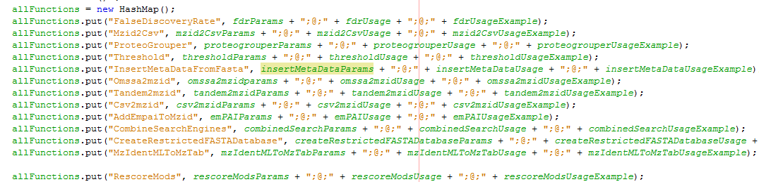
LibGui.java
Updates automatically using MzIdentMLLib.java
All routines in MzIdentMLLib.java can be called from LibGui.java using HashMap

Slide 4
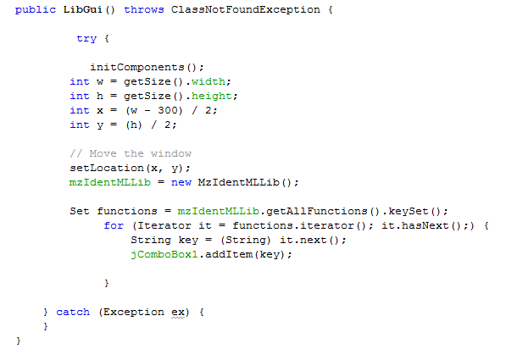
LibGui.java

Slide 5
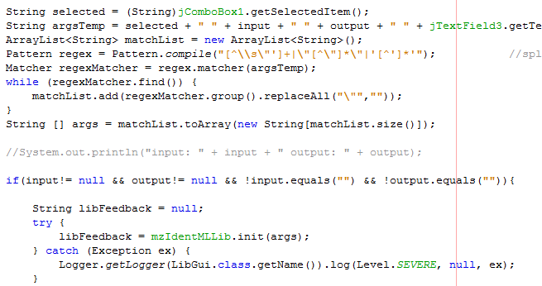
LibGui.java

Slide 6
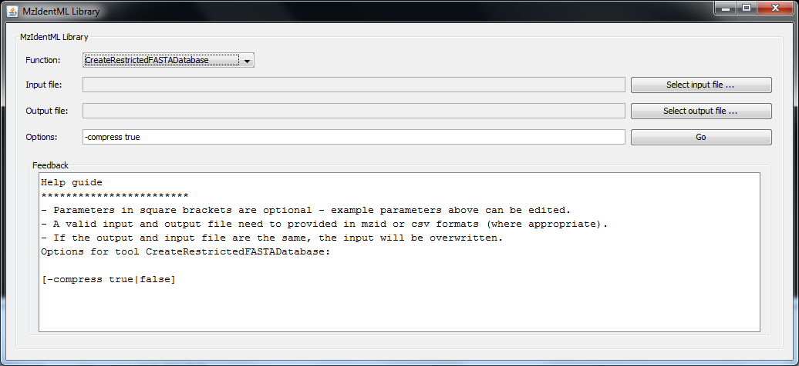
LibGUI
This interface is auto-populated from the HashMap shown previously

Slide 7
IPeak integration
I would like to propose the following method for IPeak integration:
Create a new branch off the src directory for your package (say bgi.ipeak)
All your code goes under here, if any changes are needed to the existing src, we will make those changes (to make sure nothing existing breaks
Generate an accessible class IPeak, which calls the full IPeak analysis pipeline, we can then add a call to it from MzIdentMLLib.java “java –jar mzidentml-lib.jar IPeak options…”
This would be called from the mzidLib main class (but perhaps not from our GUI)
This may exist already (RunIPeak.java) which might need almost no changes
You keep the IPeakGUI as is, allowing a specific build process for this jar (see next slide)
Percolator versions for different OS are embedded in a new folder of the mzidLibrary (Percolator.exe etc)
Various sub-routines could be created with accessible interfaces from mzidLib main and mzidlibGUI, which call various internal routines for file format conversion etc as necessary, examples:
Run percolator on OMSSA (inputs: omssa.omx [call to converter first] or omssa.mzid, output: omssa_percolated.mzid) e.g. java –jar OmssaPercolator options
Same for X!Tandem (inputs: tandem.xml [call to converter first] or tandem.mzid, output: tandem_percolated.mzid)
Same for MSGF+ (input: msgf.mzid output: msgf_percolated.mzid)
Generic percolator with mzid (input: any_mzid.mzid output: mzid_percolated.mzid)

Slide 8
Packaging
We currently offer two different mzidLib packages (mzidentml-lib.jar):
Command line
GUI version
We are now moving to having only a single build, with a separate batch file to call a specific option to start up the GUI
IPEAK GUI options:
May want the same start-up mode for the IPeak GUI e.g. “java –jar mzidentml-lib.jar IPeakGUI”
OR
May want a specific build process to make ipeak.jar, which you can then distribute on your own website: e.g. “java –jar iPeakGUI.jar”
Either is fine with us
Also possible to have own command line build of IPeak: “java –jar iPeak.jar options…”
But my preference is for easier integration in other projects to have the IPeak command line version following same style we already have though:
“java –jar mzidentml-lib.jar IPeak options…”

